Slide 1


MONTHLY UPDATE
January + February 2026
Melbourne Osteopathy Sports Injury Centre

Slide 2

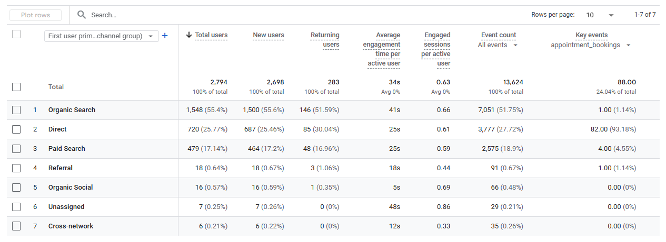
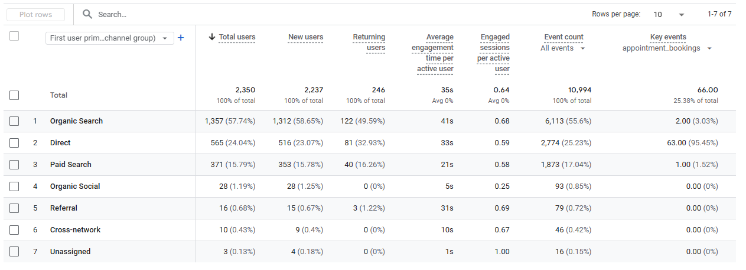
CLINIKO BOOKING PAGE
Confirmed an Appointment Booking
Month | Count
February | 66
January | 88
December | 98
November | 63
October | 85
September | 56
August | 86
July | 87
June | 88
May | 96
April | 95
March | 65
February | 68
January | 101
December | 63
January
February
Notes:
In November, there was a tonne of more Direct traffic. Highest source for that month.
December had a solid month of 98 bookings. Exceeded last year (63). More people decided to do last minute bookings?

Slide 3
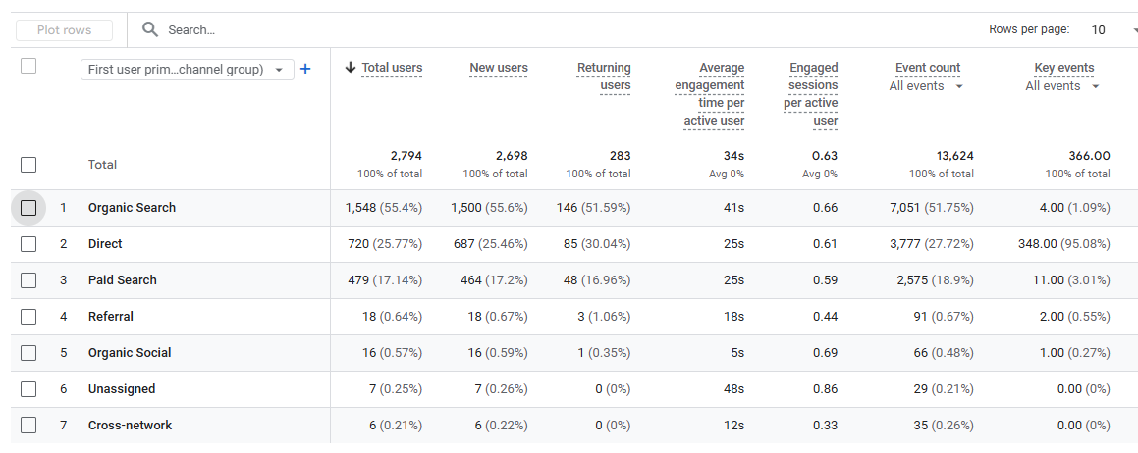
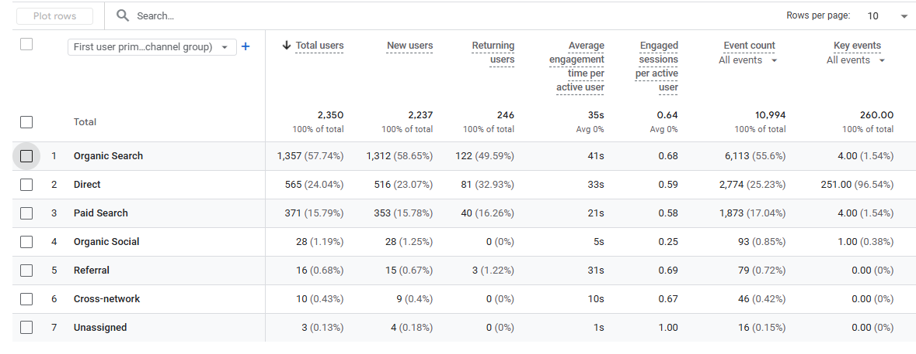
CLINIKO BOOKING PAGE
Entered the booking page
Month | Count
February | 260
January | 366
December | 370
November | 330
October | 365
September | 354
August | 469
July | 371
June | 367
May | 385
April | 447
March | 375
February | 368
January | 406
December | 236
January
February
Notes:
Very steady quarter, not a lot of fluctuations, and December performed very well. Much higher than q4 last year

Slide 4
GOOGLE ADS
Phone Calls
Month | Count
February | 23
January | 29
December | 8
November | 23
October | 27
September | 37
August | 24
July | 31
June | 30
May | 29
April | 24
March | 25
February | 31
January | 53
December | 23
January
February
Notes:
Phone calls dropped a lot… even number of clicks. Recreate the search campaigns, and adjust the copy on the landing pages. A lot more traffic but less conversion = not compelling enough landing page

Slide 5
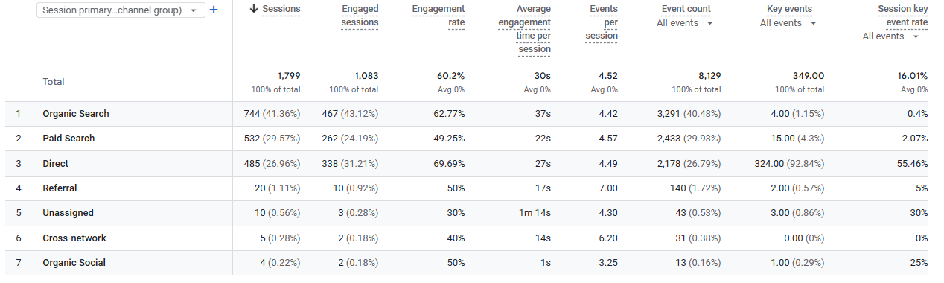
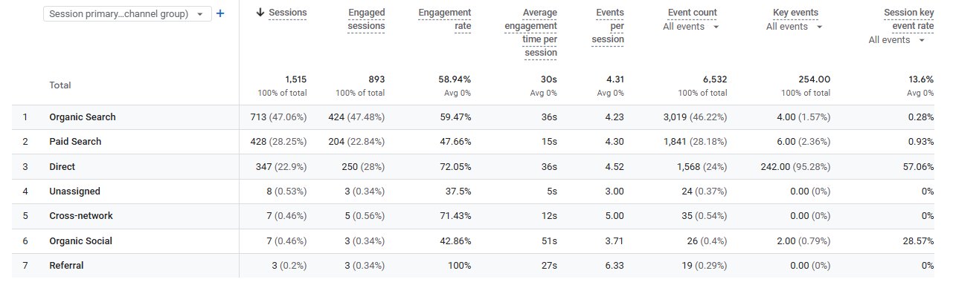
WEBSITE TRAFFIC (AUS)
Website Visitors
Month | Count
February | 1515
January | 1799
December | 1500
November | 1584
October | 1786
September | 1275
August | 1307
July | 1345
June | 1144
May | 1264
April | 1322
March | 1332
February | 1511
January | 1411
January
Organic Search
Month | Count
February | 713
January | 744
December | 600
November | 713
October | 795
September | 652
August | 601
July | 626
June | 588
May | 638
April | 668
March | 638
February | 629
January | 751
February
Notes:
A tonne more trarffic entering the website in this qtr compared to same qtr last year
A big portion is paid, and a lot of new direct traffic.

Slide 6
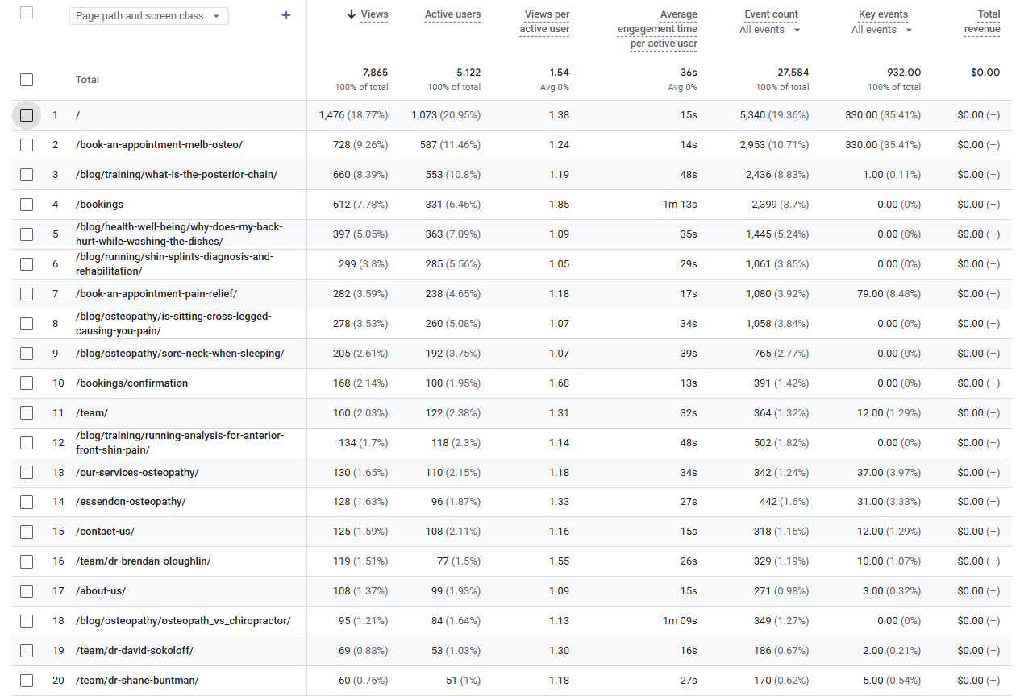
MOST VIEWED PAGES (AUS) JAN + FEB
Notes:
-Jordan still in the top 10. not as high volume
-Zac hussey ranking nicely. Most of the visits are probably me (in April). Now no longer ranked

Slide 7
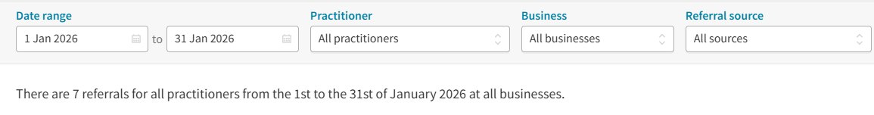
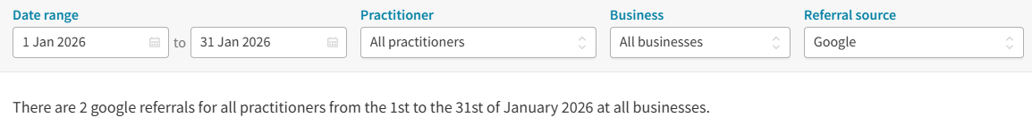
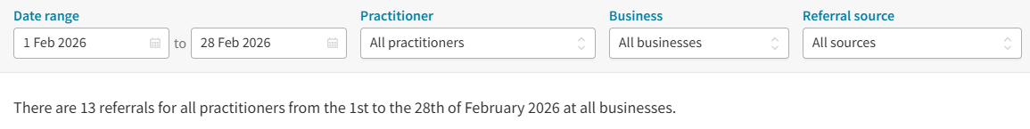
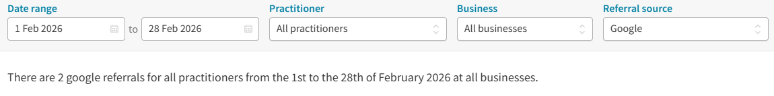
NEW BOOKINGS
New Patients from Google
Month | Count
February | 2
January | 2
December | 9
November | 4
October | 6
September | 14
August | 15
July | 14
June | 11
May | 14
April | 8
March | 2
February | 22
January | 7
January
Total New Patients
Month | Count
February | 13
January | 7
December | 18
November | 20
October | 22
September | 41
August | 37
July | 38
June | 24
May | 45
April | 27
March | 8
February | 47
January | 27
February
Notes:
In line with earlier comment. Conversion rate has fallen off a bit

Slide 8
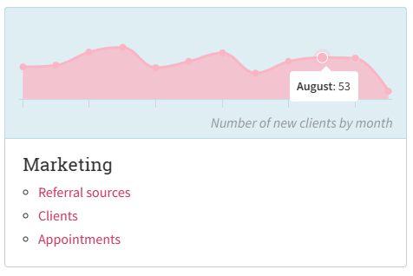
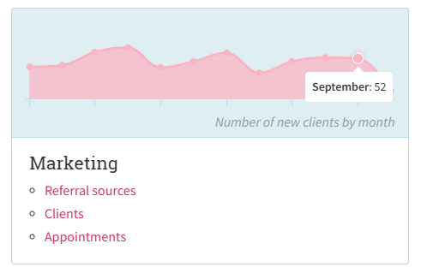
NEW BOOKINGS
New bookings based off different reporting sources
Individual Counts
New Patients from Bourke St
Month | Count
September | 21
August | 17
July | 15
June | 15
May | 34
April | 28
March | 22
February | 40
January | 37
December | 25
Report Summary Figures
New Patients from Essendon
Month | Count
September | 2
August | 10
July | 6
June | 6
May | 8
April | 8
March | 1
February | 5
January | 11
December | 7

Slide 9
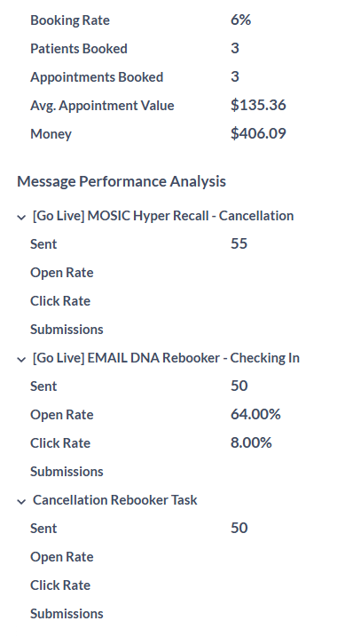
CLINIQ APPS STATS
DNA Rebooker All Patients
Month | Patients Booked | Appointments Booked
February | 3 | 4
January | 6 | 10
December | 4 | 6
November | 5 | 10
October | 4 | 11
September | 4 | 13
August | 6 | 13
Reactivation 6 – 12 Months
Month | Patients Booked | Appointments Booked
February | 3 | 4
January | 3 | 3
December | 1 | 1
November | 4 | 7
October | 11 | 25
September | - | -
August | 4 | 11
Cancellation Rebooker All Patient
Month | Patients Booked | Appointments Booked
February | 10 | 20
January | 12 | 24
December | 10 | 22
November | 13 | 27
October | 16 | 56
September | 14 | 30
August | 23 | 50
Reactivation 12 Months +
Month | Patients Booked | Appointments Booked
February | 2 | 4
January | 2 | 6
December | 3 | 4
November | 2 | 2
October | 2 | 2
September | 1 | 1
August | 3 | 5
Reactivation 3 – 6 Months
Month | Patients Booked | Appointments Booked
February | 5 | 6
January | 10 | 14
December | 3 | 3
November | 9 | 15
October | 14 | 25
September | 6 | 10
August | 6 | 8
Notes:
Solid as month for October in reactivations
Reactivations for 12months + doesn’t seem to be as effective

Slide 10
CLINIQ APPS STATS
Month | With or without appointments | Number of sends | Open Rate | Click Rate
December (End of year email) | With | 4475 | 33.97% | 0.83%
 | Without | 3004 | 21.47% | 1.53%
November | With | - | - | -
 | Without | - | - | -
October | With | 4456 | 36.94% | 0.79%
 | Without | 3023 | 23.55% | 0.63%
September | With | 4467 | 34.21% | 0.76%
 | Without | 3044 | 22.37% | 0.66%
August | With | 4452 | 44.41% | 0.58%
 | Without | 3067 | 27.19% | 0.39%
July | With | 4435 | 36.78% | 0.72%
 | Without | 3084 | 23.09% | 0.49%
June | With | - | - | -
 | Without | - | - | -
May | With | 4398 | 34.61% | 0.89%
 | Without | 3089 | 22.05% | 0.65%
April | With | 4411 | 40.81% | 0.79%
 | Without | 3107 | 24.72% | 0.39%
March | With | 4404 | 33.22% | 0.70%
 | Without | 3123 | 22.29% | 0.61%
February | With | 4405 | 32.85% | 3.27%
 | Without | 3148 | 23.06% | 3.11%
January | With | 4449 | 33.56% | 0.92%
 | Without | 3232 | 23.95% | 0.50%

Slide 11
ACTIONED ITEMS

Slide 12
WEBSITE DEVELOPMENT
Uploaded – What to expect at your first osteopathy appointment
Uploaded – Australian Open 2026 is here
Uploaded – How Osteopathy Supports better movement
Uploaded – Low Impact Exercise to Support your golf journey
Updated the landing pages to align with the search keywords
Notes:
Follow up on website changes

Slide 13
OTHER
Created the Marketing Calendar for MOSIC – Q1 Complete
Updated the Google security
Ongoing Google Ads optimisation
Ongoing social media creation and posting
Ongoing GMB posting
Update and renew all automation rework (testimonial and reviews)
Google Ads – Create new campaigns and adjust the copy
Created the co Hotdoc account for MOSIC
Notes:
-A lot of travellers booking in
-Follow up on

Slide 14
APPENDIX

Slide 15
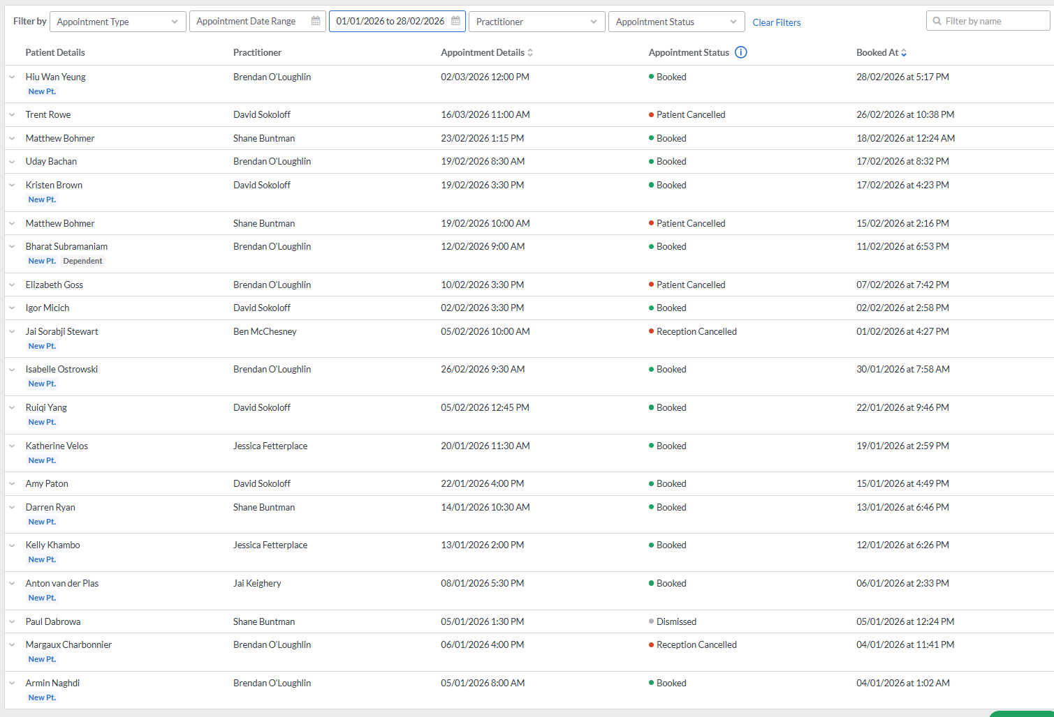
BOOKINGS FROM HOTDOC – 15 Booked
Essendon
MOSIC

